Slide 1
Analyzing Access to Patient Care
Ryan Paw
Notes:
Hi, my name is Ryan and I will be presenting my analysis on Access to Patient Care at

Slide 2


The Objective
Measure the number of appointments available to members, ensuring appropriate supply
Measure a member's experience related to appointments

Slide 3
Performance Measure Definitions
My Experience
The patient's overall satisfaction with their care experience based on a post-visit survey response. Measured as % of patient's rating their overall experience as excellent or higher.
My Convenience
The patient's ability to book an appointment at first attempt (either by phone or online) for one of their desired appointment times (can be with their doctor or another doctor). Measured as % of time booked with first attempt as % of total visits seen by department.
My Physician
The patient's ability to book an appointment with their personal care physician. Measured as % of visits with the member's personal care physician as % of the member's total visits to the department.
Notes:
My Exp
Patients overall satisfaction with their care experience
My Conv
Patients ability to book an appointment on their first attempt
This helps us understand if patients are getting their appointments cancelled or not
My Phys
Patients ability to book an appointment with their physician
This helps us understand if a patient maybe likes/dislikes their physician and are booking with their same physician over and over again

Slide 4
Central Valley Provider Details
1
2018 Oct - Dec: Physician Hours (Budget/Actual)
Central Valley Monthly Performance
2
2017 Nov - 2018 Dec: Performance for AFM Department
Northern Cal Performance
3
2018 Dec: Performance for AFM Department for NorCal sites
Notes:
I received 3 datasets related to Central Valley Medical Center, and the data supports the Adult Family Medicine department
1st dataset Provider details will help me measure the number of the appointments available, since it gives me doctor’s hours
All 3 datasets contain member experience information, so I will be able to analyze the member experience after I first measure the number of appointment available from the 1st dataset.

Slide 5
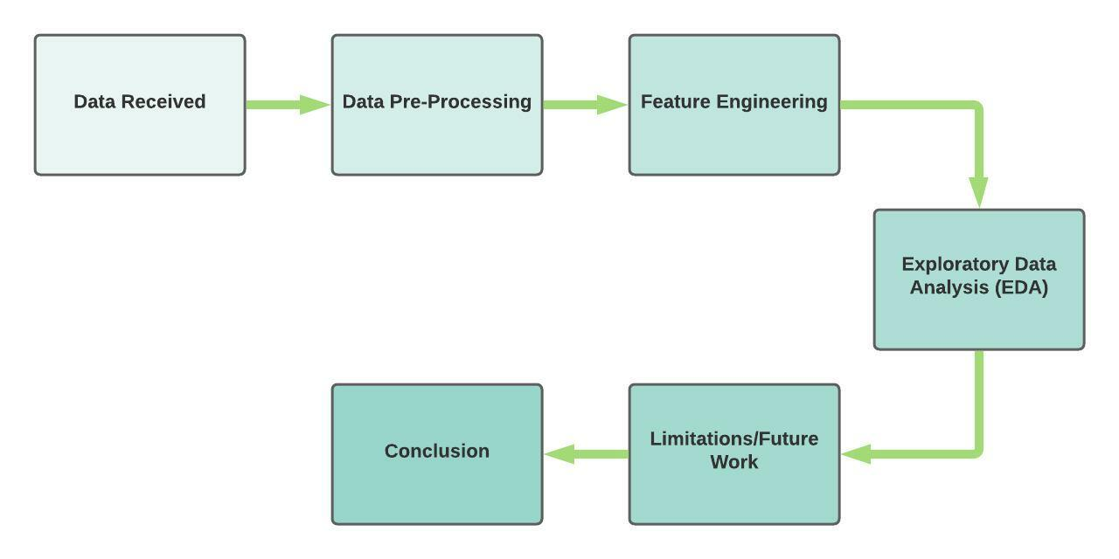
Notes:
- This is how I approached this problem….
-Data Pre-processing - creating calculated fields to setup my analysis to help answer my 2 objectives
-Feature Engineering - analyzing the features in the dataset, how they relate to each other, and choosing the best features that explain my objective
-EDA: creating visuals to make a data story to explain my objective
-Limitations/Future Work for this project
- Conclusion

Slide 6
The Objective
Measure the number of appointments available to members, ensuring appropriate supply
Measure a member's experience related to appointments

Slide 7

Calculating “In-Clinic Hours Remaining” helped me understand if Physicians are hitting their target In-Clinic Time with patients.
Notes:
To understand the availability of appointments for patients, I first wanted to know if the MD is maxed out on hours with Pt’s?
So I compared the targeted amount of hours allocated for Pt’s and compare it to the actual amount of hours spent with Pt’s. This was done by subtracting their target In-Clinic Hrs minus their Actual In-Clinic hours * 40 hrs/week
In-Clinic Hours Remaining is how much time allocated for Pts is left
Explain bar chart
0 line is the target. Meaning that if the facility is hitting the 0 line
Modesto has a lot of capacity for patients. All the doctors combined have about 17 hrs remaining for patients
Manteca is at capacity. They hit their targets, which is why they are zeroed out.
Stockton and Tracy are over-capacity, yet they continue to schedule time with patients

Slide 8
Calculating “Time Spent with Patients” helped me understand the average time Physicians spend with their patients in an appointment
Notes:
For my next step, I wanted to know on average how much time MD’s are spending with Pt’s. This will help me understand how long is the appointment time.
So I compared the number of Pt’s they saw over the course of 3 months with the actual in-clinic time, and drilled down to the average time spent with Pts.
Time Spent With Pts is the average minutes they spend with Pts in a single appointment
Across Central Valley, on average, physicians are spending 22 min with their patients during an appointment

Slide 9
Calculating “Number of Appointments Available” helped me estimate the number of appointments available each week
Notes:
Lastly, to estimate the number of appointments are available, I compared previous 2 calculations you saw earlier: In-Clinic Hours remaining and Time Spent With Patients to estimate the number of appointments available each week
So the number of appts available is the estimated number of appointments available each week
Explain bar chart:
You will probably notice that we see the same pattern compared the first calculation.
Modesto has a lot of capacity, Manteca is at capacity, Stockton+Tracy is over capacity
This is because the calculation for number of appts available uses the in-clinic hours remaining.
Modesto has more weekly appointments available (~42 appts openings avg), so they have a lot more capacity than the other central valley facilities.
Manteca is at capacity. They hit their targets, which is why they are zeroed out.
Again, Stockton and Tracy are over-capacity and exceeded the number of weekly appts available, yet doctors continue to schedule time with patients and they are overbooked

Slide 10

The Objective
Measure the number of appointments available to members, ensuring appropriate supply
Measure a member's experience related to appointments

Slide 11
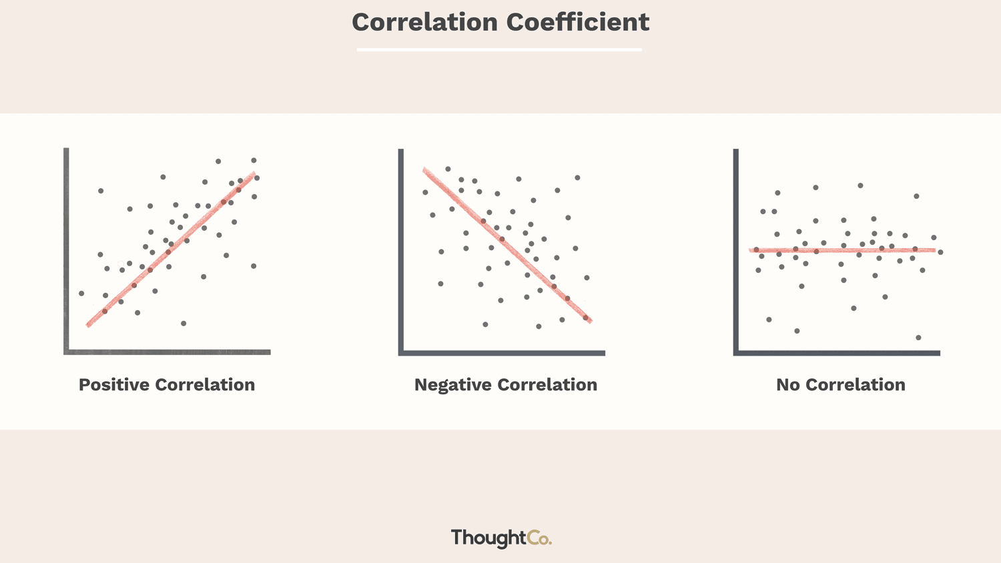
Pearson’s Correlation Coefficient (r ) measures the strength of the relationship between two variables
r =
r =
r =
-1
0
+1
-1
0
+1
-1
0
+1
Notes:
Quick overview of Pearson’s correlation coefficient
Pearson’s correlation is a spectrum between -1 to 1.
A negative correlation shows that as one variable increases, the other decreases, or vice versa
No correlation shows there is no relationship between 2 variables
A positive correlation shows that as one variable increases, the other increases, or vice versa
Therefore, no value is necessarily bad, they all mean different. because each value on this spectrum helps us understand the relationship between 2 variables.

Slide 12
There is a negative correlation between a member’s overall experience (My Physician/Convenience/Experience) related to appointments
My Physician
My Convenience
My Experience
r =
-1
0
+1
Variables | Correlation Coefficient ( r )
My Physician ↔️ Appointments Available | - 0.86
My Convenience ↔️ Appointments Available | - 0.78
My Experience ↔️ Appointments Available | - 0.76
Notes:
OK, so going back into the data…
Notice that on this spectrum, all 3 metrics are strongly negatively correlated. Again, this is not a bad thing.
This means that as all 3 metrics improve, the number of appointments available decreases
Vice versa – As all 3 metrics go down, the number of appointments available increase
Alright, so what does this mean?

Slide 13

WHAT DOES THIS MEAN???

Slide 14


When patients’ overall experience increases, the number of appointments available decreases, vice versa
Notes:
In-N-Out
That’s WHY I keep returning
- Because on average, everyone else’s experience is amazing too, so everyone’s going to In-N-Out, which means low availability
-Doctor-Pt relationship

Slide 15
How do we improve the overall member experience???

Slide 16
Top 3 Correlated Features : “In-Clinic Hours Remaining” and “Actual Leave Time” have the strongest relationships
My Experience
1. In-Clinic Hours Remaining (-)
2. Appointments Available (-)
3. Ratio of Patients Seen/Assigned (+)
My Convenience
1. Actual Leave Time (-)
2. Appointments Available (-)
3. In-Clinic Hours Remaining (-)
My Physician
1. In-Clinic Hours Remaining (-)
2. Appointments Available (-)
3. Ratio of Patients Seen/Assigned (+)
Notes:
Out of the all the features in this dataset, I’ve listed the top 3 most correlated features for My Exp, Conv, and Physician.
Immediately you’ll notice ”In-Clinic Hours” and “Actual Leave Time” are highly correlated with these metrics
In-Clinic Hours Remaining is the amount of hours remaining with patients after subtracting their target minus their actual hours
Actual Leave Time is the budgeted leave time (vacation/sick/holidays)
+ / - signs indicate a positive or a negative correlation
These top features make sense….
When the patient experience goes well, there is a decrease In-Clinic Hours Remaining (Pts love that MD).
Same with My Physician, when they like their doctor, they want to book with the same doctor again and again…but also reduces the availability for the doctor
My Convenience makes sense too…if doctors are taking more leave time than is budgeted, it correlates to cancelled appointments. Doctor’s need a break too, but need to keep in mind, this will affect patient convenience

Slide 17
Central Valley: "My Experience" Monthly Distribution
Notes:
Winter months are notorious for cold/flu season, which could explain the peaks in the beginning
Summer months are the opposite and we see that My Experience dips below our target Experience threshold

Slide 18
Central Valley: "My Convenience" Monthly Distribution

Slide 19
Central Valley: "My Physician" Monthly Distribution
Notes:
Distribution is the similar to “My Experience” and “My Convenience”
Peaks in the winter, dips in the summer, and a steep decrease in Oct
This shows that these 3 metrics are positively correlated with each other. Each metric complements each other
So if we see “My Experience” go up, the other metrics will follow

Slide 20
Norcal: “My Experience” Top Performers
Notes:
1. Southern Alameda
2. San Jose
3. North Valley + Santa Rosa

Slide 21
Norcal: “My Convenience” Top Performers
Notes:
1. Southern Alameda
2. Santa Rosa
3. South San Francisco
A lot of facilities are hitting below the target Convenience. This Norcal data is during Dec 2018.
Dec is one of the busiest holiday months, so it makes sense that we might see more cancelled appointments affecting “My Convenience”

Slide 22
Norcal: My Physician Top Performers
Notes:
1. Santa Rosa
2. Southern Alameda + San Jose
3. North Valley

Slide 23

This analysis was limited to the % of My Experience/Convenience/Physician. Future work would analyze post-visit survey responses.
Notes:
Limitations/Future Work
To understand more about the Pt experience, I would first look into the post-visit survey responses
This will help me understand what aspects of their experience went well/did not go well so we can understand how to further improve it.
If it’s not already covered in the survey, I would want to know on a rating scale:
How long did they wait in the reception area?
How long did they wait in the examination room before speaking with a doctor?
What was the overall cleanliness of the office/clinic?
Did the doctor listen to your concerns?
Was the doctor polite or respectful?
Understanding more about the Pt experience, would help understand how to improve the overall Pt experience

Slide 24
Summary
Measure the number of appointments available to members, ensuring appropriate supply
Measure a member's experience related to appointments
Notes:
I measured the number of appointments by first:
Calculating “In-Clinic Hours Remaining” helped me understand if Physicians are hitting their target In-Clinic Time with patients
Then, Calculating “Time Spent with Patients” helped me understand the average time Physicians spend with their patients in an appointment
Finally, Calculating “Number of Appointments Available” helped me estimate the number of appointments available each week
I measured a member’s experience related to appointments by:
Finding a negative relationship between a member’s experience related to appointments
When patients’ overall experience increases, the number of appointments available decreases, vice versa
“In-Clinic Hours Remaining” is most correlated with My Exp/Phys and “Actual Leave Time” is most correlated with My Conv
Lastly, I looked into the top performers for Central Valley and Norcal

Slide 25
References
Jay, R. (2019, February 5). Here's what survey respondents say about the finances of freelancing. FlexJobs Job Search Tips and Blog. Retrieved January 12, 2022, from https://www.flexjobs.com/blog/post/heres-what-survey-respondents-say-about-the-finances-of-freelancing/
Kaiser Permanente (2018). Department Case Study [Data set]
Nickolas, S. (2021, December 7). What do correlation coefficients positive, negative, and zero mean? Investopedia. Retrieved January 12, 2022, from https://www.investopedia.com/ask/answers/032515/what-does-it-mean-if-correlation-coefficient-positive-negative-or-zero.asp
Notes:
These are my references

Slide 26
Thank you for listening!
Questions?

